Slide 1

Grant Discovery and Resources

Slide 2

About Us
The Governor’s Office of Federal Assistance, or OFA, was created with the passage of Assembly Bill 445 of the 81st Legislative Session
Vision
The Governor’s Office of Federal Assistance supports our stakeholders in obtaining, increasing, and maximizing federal assistance.
Mission
The Governor’s Office of Federal Assistance reduces barriers by providing inclusive, collaborative, comprehensive, and centralized support in obtaining federal dollars for Nevada.
Notes:
The Governor’s Office of Federal Assistance, or OFA, was created with the passage of Assembly Bill 445 of the 81st Legislative Session
Vision
The Governor’s Office of Federal Assistance supports our stakeholders in obtaining, increasing, and maximizing federal assistance.
Mission
The Governor’s Office of Federal Assistance reduces barriers by providing inclusive, collaborative, comprehensive, and centralized support in obtaining federal dollars for Nevada

Slide 3

General Housekeeping
Welcome
Training will be recorded and will be stopped during Q&A
Today’s training video and the resources shared will be posted to our website
If you have a question, drop it in the chat
Close Captioning is available, please click the CC button at the bottom of your screen

Slide 4



Meet your Trainer
Kylie Howard
Executive Grant Analyst
Notes:
Kylie Howard is a Executive Grants Analyst and Public Information Officer. She works to maintain the database of federal funding opportunities on our website and manages our Notice of Funding Opportunity Form and submissions. Kylie Howard comes from the Nonprofit industry where she engaged in grant discovery for the cultural industry.

Slide 5

Learning
Objectives and Goals
Before the Search – Getting Set Up for Search Success
Resources for Locating Federal Grant Opportunities
Learn About the Free Grant Discovery Software - Created in Partnership with U.S. Digital Response
Completing that Grant Fit Check – Making Sure the Federal Grant is a Good Fit for Your Program/Project
Notes:
Applying for a grant can feel especially intimidating if you have never done it before or don’t know where to start. We are excited to be offering this training to help you engage in grant discovery and we are excited to be continually offering monthly trainings on different aspects of the process of grants management. After todays presentation I highly encourage you to watch our Grants 101 presentation and stay tuned for future announcements.
READ SLIDE
Okay now that that is out of the way lets talk about getting set up for success in your grant search. This can be tedious but if you do just a couple of things you can cut down the time searching for grants immensely.

Slide 6

Know What You Are Funding And Generate Keywords
What type of grant are you looking for:
  General Operating Support
  Technical Development
  Capacity Building
  Capital Funding
  Program/Project Specific
    Is the project fundable? (Compatible with your agency’s central mission or purpose)
  Are other agencies doing similar work?
    Can you collaborate
    Are you filling a specific niche
  Develop Keywords
Notes:
First you have to know what you are looking for. What kind of grant are you looking for? General Operating Support, Technical development/Capacity building? Capital Funding, or Program/Project specific?
Is the project fundable - What are the deficiencies, the strengths, the inputs and the outputs?
Why should a funder support this project or program? Is the project fundable? By that I mean is the project/program compatible with your agency’s central mission or purpose?
Are other agencies doing similar work? If so – have you explored collaboration? Or are you filling a specific niche?
Take some time to identify exactly what you are looking for and identify keywords to help your grant discovery go smoother.

Slide 7

Understand Your Capacity And Timeline
Engage in early project management
  Who will write the grant?
  Who will manage the grant?
  When do we plan on offering services funded by the grant?
  How much money is needed for the program to be successful? Etc.
Generate a timeline and work backwards
  Project Start Date and estimated time to completion
  Grant Award Date
  Grant Close Date
  Time to Prepare Grant Application
  Grant Opens
  Grant Discovery
Notes:
One of our next big tips is to engage in project management before you even go looking for a grant.
Answering questions like :
Who will write the grant?
Who will manage the grant?
When do we plan on offering services funded by the grant?
How much money do we need for the program to be successful? Etc.
Can give you a jumpstart on understanding the process wholly before beginning your search. Generate a timeline so you know when you need the funding and then you can work backwards.
BACKWARDS LIST:
Grant Close date,
Time to prepare application,
Grant Opens
Grant Discovery

Slide 8
Four Filters Plus One Method
Method is from
“Storytelling for Grantseekers: A guide to Creative Nonprofit Fundraising”
4
+1
Four criteria to sort funding
  Subject area
  Geographic preference
  Type of financial need
  Typical dollar range of grants awarded
Relationships
Any connections between you and a potential grantmaker?
Notes:
And finally figure out your filters.
This method comes from “Storytelling for Grantseekers: A Guide to Creative Nonprofit Fundraising”
Four criteria to sort funding:
Subject area
Geographic Preference
Type of Financial need
Typical dollar range of grants awarded
And the Plus One = Relationships. Any connections between you and a potential Grantmaker?
“A tip for making research more efficient: review the first two criteria (subject matter and geography) before going any further. If you identify a funder that supports agencies doing the work that yours does, but sets geographic restrictions on its grantmaking, and your agency doesn’t fit within the geographic boundaries, then STOP! Don’t read another word. You’re only wasting your time by reading about a funder that does not fund in your area or does not fund the type of work that your agency does.”

Slide 9

Federal Grant Research
OFA.nv.gov
Subscriptions Options
  Foundation Directory
  Grant Station
  Grant Gopher
State Agencies
Grants.gov
USDR Grant Discovery Tool
Notes:
Now that we have identified the program, keywords, timeline, and main sorting criteria we can begin to look for a grant. There are several places you can begin your search such as OFA.nv.gov, Subscription Websites and Online Directories, State Agencies, Grants.gov, and specialized grant discovery Tools such as the USDR Grant Discovery Tool we just launched.

Slide 10
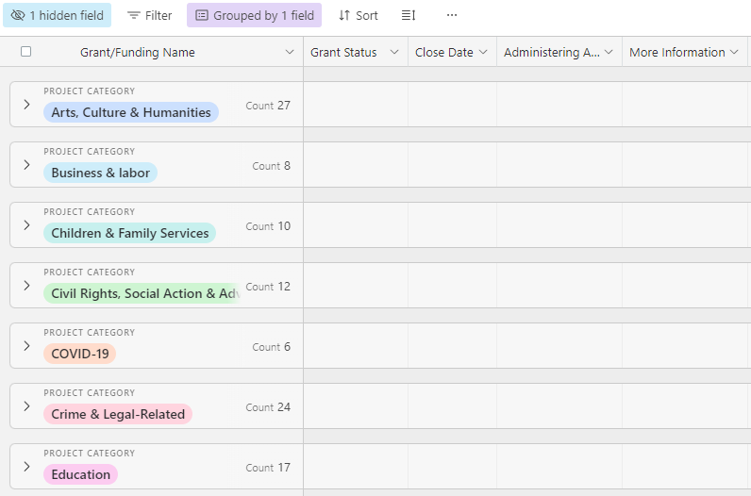
OFA.NV.GOV
Funding Opportunities
Powered by our Notice of Funding Opportunity Form (NOFO)
Federal, State, Foundation Support listed
Sort by project type, close date, administering agency, and eligibility
Over 500 opportunities listed
Notes:
Our website shares out funding opportunities powered by our Notice of Funding Opportunity (NOFO) form. This database has over 500 opportunities listed that you can support by project type, close date, administering agency (such as federal, state, and foundational support), and even eligibility.

Slide 11



Subscription Websites & Online Directories
Grant Station
  Various searchable directories as well as a nonprofit grant database
The Foundation Center
  Nonprofit organization with a large database, purchase required
Grant Gopher
  Grant aggregator, shows opportunities while available
Notes:
Look at various subscription-based websites such as the Foundation Directory, or Grant Station (links are being placed into our chat box and can also be found on our website)
You can always look at and register directly with federal and state agency websites and get on their list serv so that you receive email notification of new grant opportunities. Just as a note, our team does not endorse any subscription website or tool.
Most commonly Grants.gov is the go-to for searching for grants – they now have a convenient phone or mobile app that you can download.

Slide 12



State Agencies
Governors Office of Economic Development
Nevada State Infrastructure Bank
Office of Science, Innovation, and Technology
Other Agencies as Applicable (such as Tourism, Agriculture, Etc.)
Notes:
Provide examples of state opportunities and funding that individuals could explore, there’s always valuable information on individual agency websites --
Some general state resources to be aware of:
GOED
Objectives, as identified in the first State Plan for Economic Development are:
Establish a cohesive economic development operating system.
Increase opportunity through education and workforce development.
Catalyze innovation in core and emerging industries:
Advanced Manufacturing
Technology
Energy (Including Lithium)
Health
Operations Logistics
Startup/Venture Capital
Advance targeted sectors and opportunities in the region.
Expand global engagement.
Nevada State Infrastructure Bank (SIB): was established to provide low-cost financing to NV state agencies, local governments, tribal governments, and nonprofit organizations for priority infrastructure projects
Can provide financing for transportation facilities, utility infrastructure – etc.
Office of Science, Innovation, and Technology
Charged with administering grants that are provided by legislative appropriation and other STEM and broadband related grants from the federal government and some form private foundations –current funding opportunities include K-5 STEM Grant, Workforce Challenge Grant, STEM WF talent pipeline development grant and the designated stem school grant – all which can be found on their website at osit.nv.gov
Also, the USDA Rural Development – they have various opportunities worth exploring, focused heavily on rural communities.
Remember, understand what you are looking for and explore.
Another example is the Nevada Division of Tourism who has rural marketing grants, a 3-D destination development grant as well as support through the Destination Nevada Academy for rural partners – information can also be found on their website at travelnevada.biz. This is just one example of a state agency that awards funding either designated by the state or as pass-through federal funding. Find the agency that best fits with the work you are doing and learn more about what funding they offer.

Slide 13
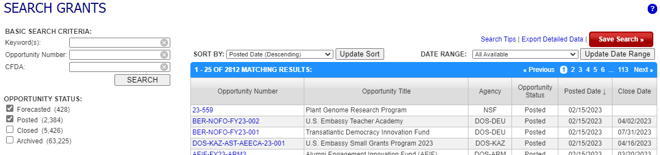
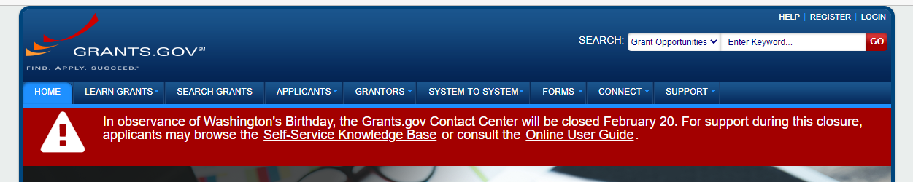
Grants.Gov
Database
  Features thousands of grants
  List of grant-making agencies
Resources
  Grant Policies
  Grant Eligibility
  Grant Terminology
Notes:
This is the usual go to for grant research. It does provide that database that features thousands of grants as well as the list of the grant-making agencies. The more you use it and really, the more you take the time to explore it and the various resources it provides, the much more comfortable you will become with it.
Grants.gov does have a comprehensive list of resources that I find helpful, including trainings/presentations and general information on grant management – resources include grant policies, explanations as to grant eligibility as well as a comprehensive list of grant terminology.
Don’t forget your 4 sorting criteria here! Narrow down first by Subject area and Geographic Preference and utilize your keywords and project timeline!

Slide 14
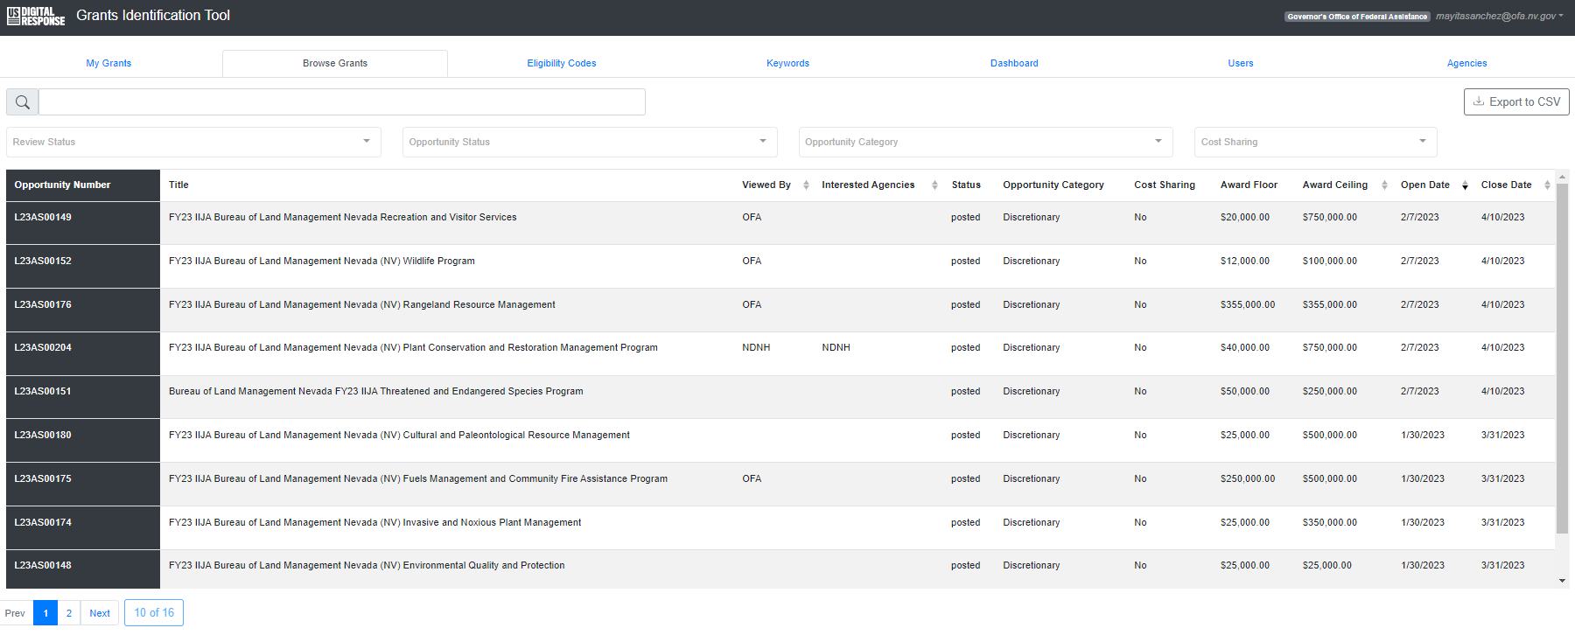
Available Now US Digital Response Grant Identification Tool
Automate Grant Discovery
Set Keywords and Eligibility Codes that will Always Save
Identify Collaborators across various stakeholder groups
Receive push email notifications
Bookmark Grants of Interest
Assign grants to other users
Notes:
The Governor’s Office of Federal Assistance and USDR are working together to provide users with the ability to search for grants with ease and efficiency, along with expanding opportunities for collaboration with other grant seekers. Our efforts to offer this FREE federal grant discovery tool statewide is the first in the Nation. Interested in moving your grant discovery to the next phase? You can sign up for the tool on our website.
(Ask Mayita what else she wants here)

Slide 15
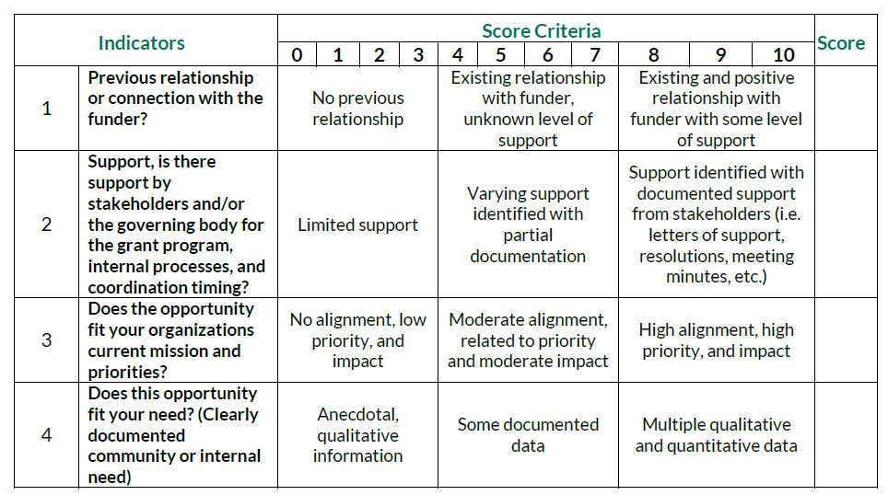
Grant Fit Check & Template
Does it fit current priorities, needs, mission, vision, goals?​
Existing relationships you can capitalize on?​
Previous relationship or connection with the funder?​
Is the grant application deadline feasible?​
Are the grant related activities manageable?​
Application Readiness​
Fillable Form Online
Notes:
It is always beneficial to check to see if a grant is a good fit for your organization. You can do this by asking a few questions, such as:
Does it fit your current priorities, needs, mission, vision, and or goals
Are there existing relationships? If so, capitalize/leverage them.
Do you have a previous relationship or connection with the funder
Can we meet the grant application deadline? Begin with the end in mind.
Can we manage grant related activities?
Have we discussed our application readiness?
How do I know whether a grant opportunity is a good fit for my organization? It is important to consider various indicators when researching grants and whether you are well positioned to develop and apply for a grant opportunity. There are various guiding questions that can be asked to begin this conversation and to conduct a “grant fit check”. OFA has created an example of how an organization can rubric an opportunity under consideration.
I will walk through the templated form with them and the various indicators to help them understand the rubric process and how it can benefit their grant discovery/decision making.

Slide 16






Reminders
&
Best Practices
Read, read, and read
Plan Ahead
Timing
Understand what you are looking for
Establish a network and build relationships
Explore underrepresented funding opportunities
Notes:
Reminders and Best Practices
If this is your first time registering with grants.gov, always read the registration instructions carefully and prepare all your information to aid you in that process.
Remember, organizations also must have an active System for Award Management or SAM registration that is valid – this provides the organization with their Unique Entity Identifier number (UEI)
Also Remember, SAM is slow – it can take several weeks, if not longer, for an organization to successfully be registered with SAM –so make time and do this far in advance so that you are not scrambling or missing any required application submission deadlines. At least a month – don't wait until the week of.
If you ever get stuck, you can always reach out to us, and we can provide limited technical assistance with both SAM and grants.gov
Make time to submit your workspace and plan! You do not want to wait the day of to submit your application just in case you run into a technical program, or it’s bogged down because various applications are being uploaded at the same time. Have your information and resources handy, and make sure you have the most current versions – get organized.
Remember to always have that end in mind – create your research plan and really understand what you are looking for. Establish your network, keep track of the information you collect, the contacts that you make, and build your relationships.
Let people know what you’re looking for so that if they see an opportunity that may be a good fit for your organization, they reach out to you, or vice versa, if you see a good fit for them, bring it to their attention –
An organization can also explore underrepresented funding opportunities – remember know your need – is the organization or business owned by women, a veteran, a minority group – many funders create grants specifically dedicated to underrepresented groups, so explore.

Slide 17

Don’t Forget
Single Point of Contact and the Intergovernmental Review
  SPoC
  OFA is the Designated Single Point of Contact
  Presidential Executive Order 12372
  Coordinate in-state grant applications
  Foster intergovernmental relationships

Slide 18
OFA Services
Notice of Funding Opportunity and Database
Grant Manual – Update coming in a couple weeks
Free Technical Assistance
Free Monthly Training and Technical Assistance
  Upcoming: Navigating Nevada State Processes for Federal Grants Timelines - May 24th, 10:00 AM
  Grants 101 available on our website now
  Federal Grant Matching & the NV Grant Matching Program
Sign up for the OFA Newsletter so you don’t miss anything!
Notes:
OFA provides a variety of grant related resources including the notice of funding opportunity and funding database we discussed earlier, a comprehensive grant manual (update version will be available on our website next quarter), free monthly trainings and technical assistance. For technical assistance please Our monthly trainings are free and open to the public and they are also posted to our website. We recently uploaded our Grants 101 training which you can access by following the link in these slides or visiting our website.
Our next training will be March 29th and will cover Federal Grant Matching and the NV Grant Matching Program.
Finally, we offer several additional resources on our website and a monthly newsletter where you can stay up to date with funding opportunities, upcoming training, and monthly tips and tricks.

Slide 19
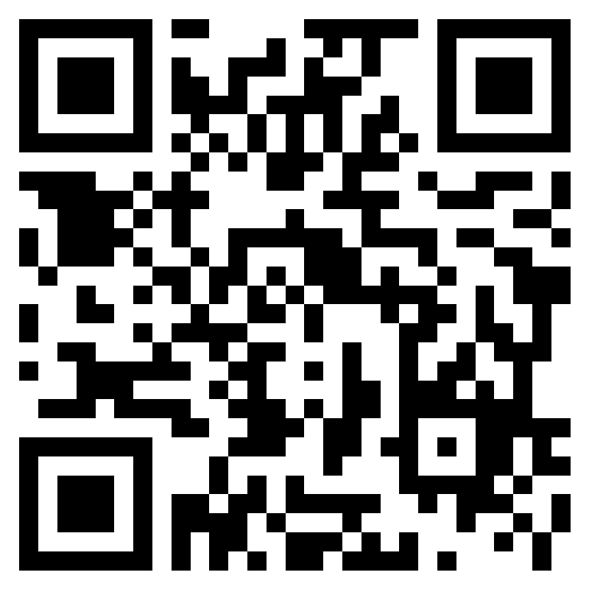
Grant Discovery & Research
Training Survey

